Slide 1
Civic Tech Project Blueprint
Code for Philly

Slide 2
Welcome!
Why did we create this Blueprint?
We acknowledge that our Code for Philly community members likely have little experience volunteering or leading a civic tech project.
Accordingly, volunteers are actively looking for guidance on how to get started and how to contribute.
Here you’ll find answers to...
What are Code for Philly projects and what do they often look like?
How can I become involved in an existing project?
How can I lead my own project?
Who is the primary audience for the Blueprint?
We hope first-time volunteers find this Blueprint helpful.
When should it be used?
When community members are serious about getting involved in their first project - either as a contributor or founder.

Slide 3
Code for Philly Project 101
Why projects?
Projects are an excellent mechanism to translate civic improvement ideas into civic action
Projects provide just-enough structure to facilitate volunteer contributions and collaboration
Project Guidelines
Project intent must be to deliver a public good or service
Projects should be non-profit, non-partisan
All project materials (e.g. code, data, and insights) should be made available under an open source license
Projects should create and maintain an entry on codeforphilly.org
Typical Project Outcomes
Common Deliverables
  Open-source functional proof-of-concept and/or MVP solutions - ready for adoption and reuse
  Data-driven advice on a public good / civic issue
  Technical consulting and/or user research for existing public services
Common Benefits
  Increased civic engagement - among Philadelphians as well as project team members
  Upward mobility of a person/people involved in the project
Notes:
https://codeforphilly.org/pages/project_guidelines

Slide 4
Project Team Roles
Required Roles
Lead Project Advocate
Lead Maintainer (eg Technical Lead)
*can be the same person
Optional Roles
Contributor (eg dev, designer, marketer, tester, etc)
3rd Party Partner
External Stakeholder
Founder
Why require roles?
Having a project point of contact helps our Leadership Team provide administrative support.
Strategically, it helps new volunteers and external stakeholders engage with your project.

Slide 5
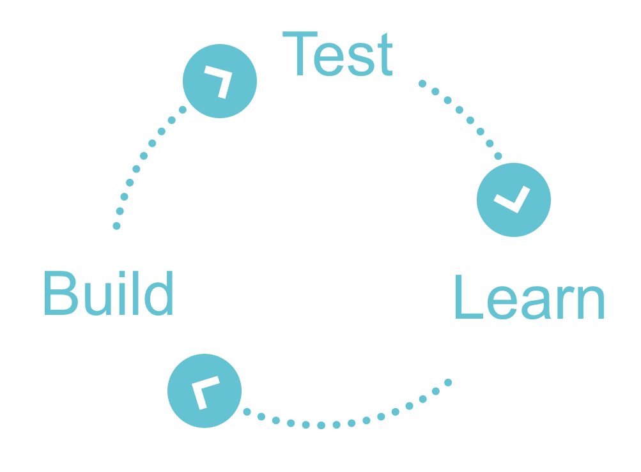
Project Stages - TEAM discussion and design help required
Time
Idea Discovery
Iterative Project Execution
Delivered & Deployed
Collect ideas
Investigate the opportunity
Understand your stakeholders
Appreciate existing services
Documented project vision with phased roadmap
Demo or launch
Summarize learnings
Package for the future
(eg partner org adoption, future forking friendly)
Dormant or Archived - Ready for reuse, forking, or redploy

Slide 6
How to get started right now!
Create a profile on codeforphilly.org
Say hello in our Slack community’s #General channel
Browse our community’s existing projects
Find a project of interest? Introduce yourself within the project’s specific Slack channel.
What to begin your own project? Start here.
Have questions? Reach out to our Leadership team at any time.
Email us at hello@codeforphilly.org
In Slack - within either the #General or #new-member channel

Slide 7
Advice for contributing to existing projects
Basics
Create a profile on codeforphilly.org that includes a brief description of your interests, skill sets, and contact info
Become a member of our Slack community. Introduce yourself in the General channel!
Browse our community’s existing projects on codeforphilly.og
Obvious, but crucial
As a volunteer effort, select a project whose mission aligns with your own personal interests
Introducing yourself
If the project has a Code for Philly Slack channel, then we generally recommend you introduce yourself there. Else, you can email the project lead by finding their email on the website.
During your introduction, make sure to share a brief background, why you’re interested in the project, and how you could possibly contribute. Don’t worry though, you can work out details later.
Getting started
Respect the time of existing project members. Read any documentation and follow setup instructions
Show you’re making an active effort. It will build trust and goodwill with the project team.
Ask for specific help to make it easier to triage issues. It also helps update procedures for future volunteers!

Slide 8
201 Level - Project Success Advice
Keep connected to the ‘cause’ and mission. Ideally, find a stakeholder group / 3rd party partner to collaborate with.
Keep it fun, respect everyone
Keep the scope small; and break larger deliverables into smaller milestones

Slide 9
301 Project Advice - Attracting and collaborating with volunteers
Attracting Interest
Ensure your codeforphilly.org project page is current, clear, and succinct
Showcase your progress - both big and small - so volunteers can see you’re actively working
Attend our Hack Nights and Open House Events - meet the community, tell your story, ask for advice and encourage others to pitch in
Onboarding
Your project’s README file (ideally on both GitHub and codeforphilly.org) should include self-service friendly setup directions
You should also link to your public ‘project backlog’ that describes what you're working on now and what needs tackled next.
Show new volunteers empathy - getting started can be the most painful part of volunteering
Collaborating
Be clear about how your team will communicate (eg virtual vs in-person meetings, hybrid, etc)
Make all work (current and future) visible and browsable. Volunteers can only work on issues they can read, comprehend and identify how it helps the broader mission

Slide 10
Criteria to become a Verified, Volunteer-Ready Project
Codeforphilly.org Project Record which includes
Lead Project Advocate identified
  Bonus points: Backstory of project advocate’s interest in the project
Technical README file posted / linked from Github repo
  Including tech stack being used
Project Objectives
  Clear project mission
  Clear opportunity statement
  Clearly end-goal vision for how to meet the challenge/opportunity
Community Engagement Practices
  How are you engaging with your stakeholders / users / communities?
  Do you have a dedicated 3rd party partner?
  What and how are your learning about and testing your ideas with the broader community?
Volunteer Management Criteria:
Clearly articulated needs for additional project volunteers on either codeforphilly.org or Github (can be task, issue, or role based)
      Defined role and involvement expectations
Defined and configured digital task management tool (eg Github issues, Github projects, Waffle board, Trello, etc)
Defined team communication methods (eg Slack channel, in-person meetup schedule, Google Hangouts, etc)

Slide 11
Open Source Development References
https://dreamsongs.com/IHE/IHE-52.html
https://opensource.com/resources
https://opensource.com/resources/what-open-source
https://startbigthinksmall.wordpress.com/2011/08/10/for-beginners-how-does-open-source-work/
https://opensource.com/life/11/3/how-become-amazing-contributor-open-source-project
https://opensource.com/life/13/10/ten-ways-open-source-projects
https://docs.acquia.com/article/how-does-open-source-community-based-software-work

